Slide 1

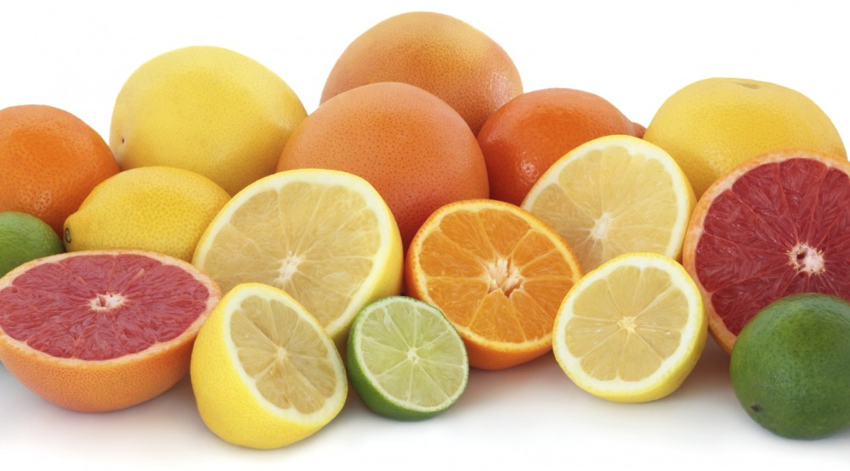
Citrus Disease
Kasen Sherrard #7489 #US213
(citrus, 2021)

Slide 2
(citrus, 2021)
Notes:
No “hook” on this slide

Slide 3
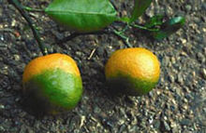
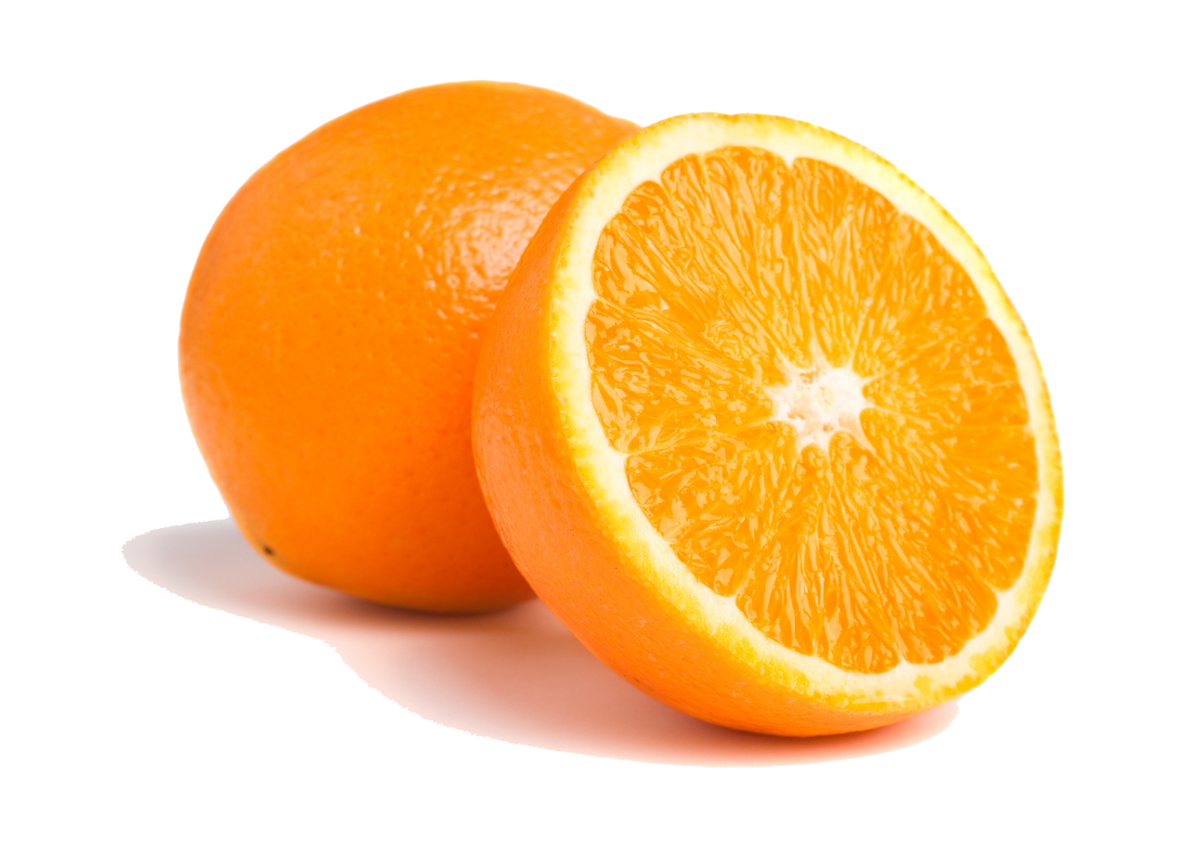
Defining the Problem
(orange with citrus greening disease, 2021)
(orange half, 2021)

Slide 4
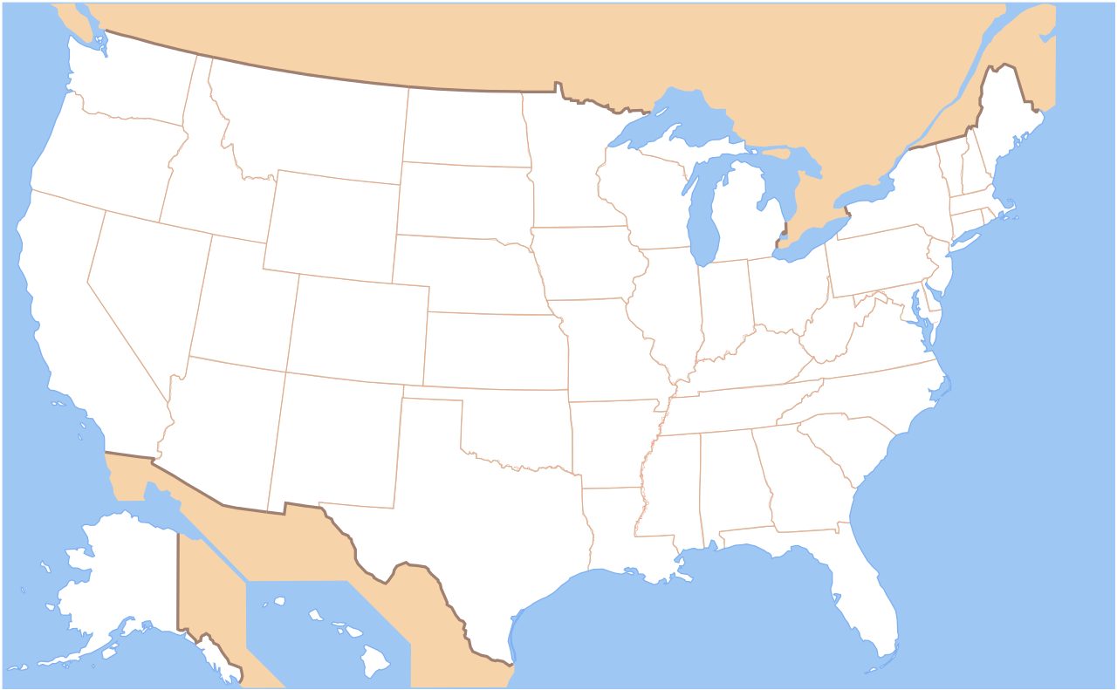
Citrus Disease in Florida
(map of united states no words, 2021)

Slide 5
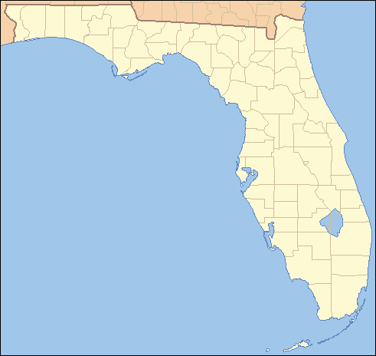
Citrus Disease in Florida
(map of florida no words, 2021)

Slide 6
Group Perspectives:
Citrus Disease
Scientists
Government
Economy
Environment
Notes:
Define (EXPLAIN) all the perspectives to get 5 pts

Slide 7
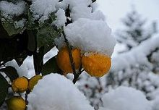
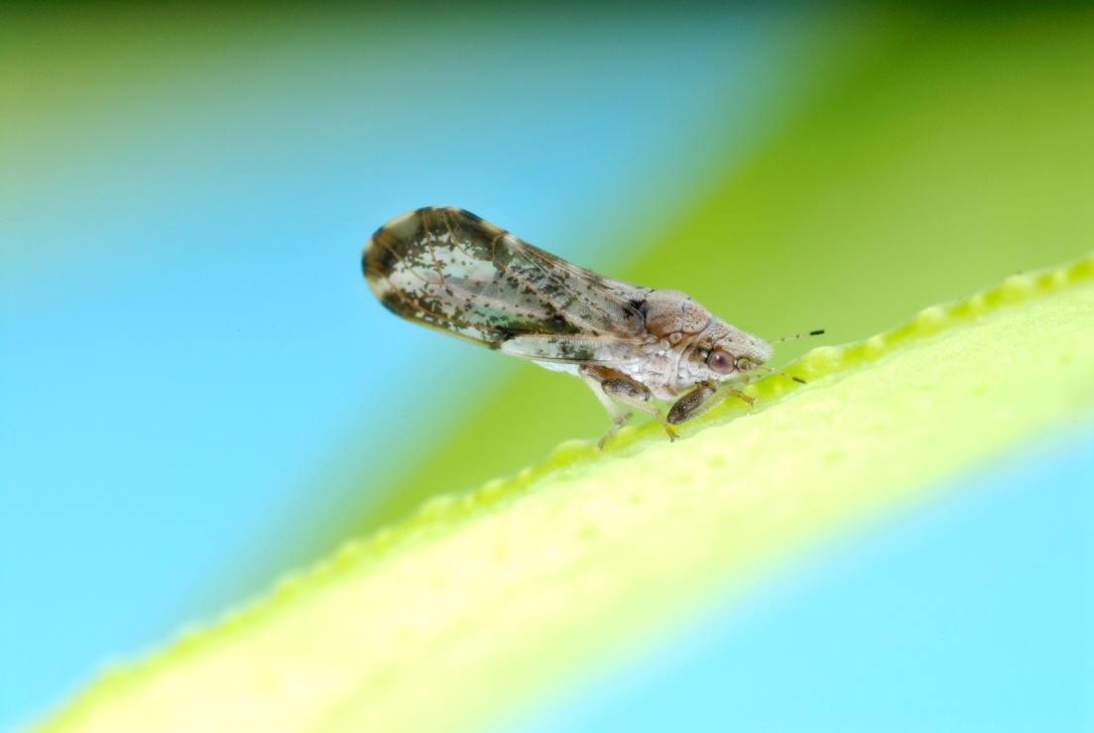
Environment
(snow on citrus trees, 2021)
(citrus psyllid, 2021)

Slide 8
Reasons
Environment
Animal Life
Temperature

Slide 9
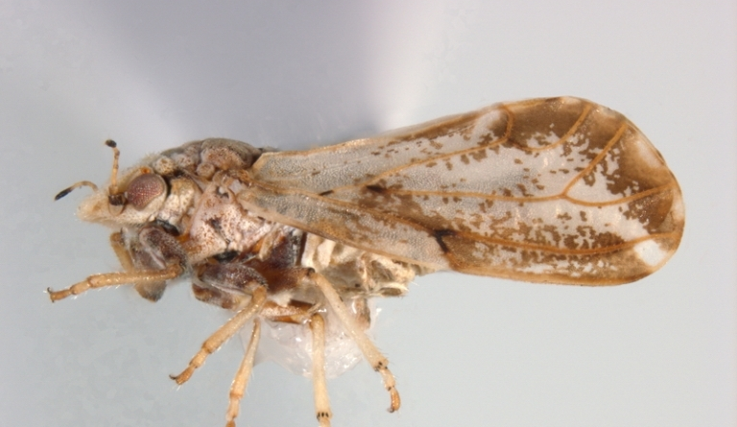
Animal Life
(Local)
(asian citrus psyllid, 2021)
(asian citrus psyllid, 2021)
Notes:
These should all say WHERE they are from, not just local and global

Slide 10
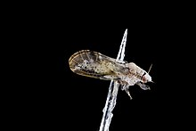
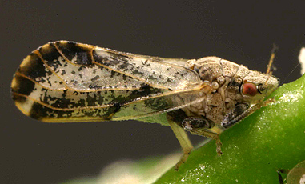
Animal Life
(Global)
(african citrus psyllid, 2021)
(african citrus psyllid, 2021)

Slide 11
Temperature
60° F
(15.6° C)
(Local)
70.7° F
(21.5° C)
91° F
(32.8° C)

Slide 12
Temperature
(Global)

Slide 13
Recap
Environment
Animal Life
Temperature

Slide 14
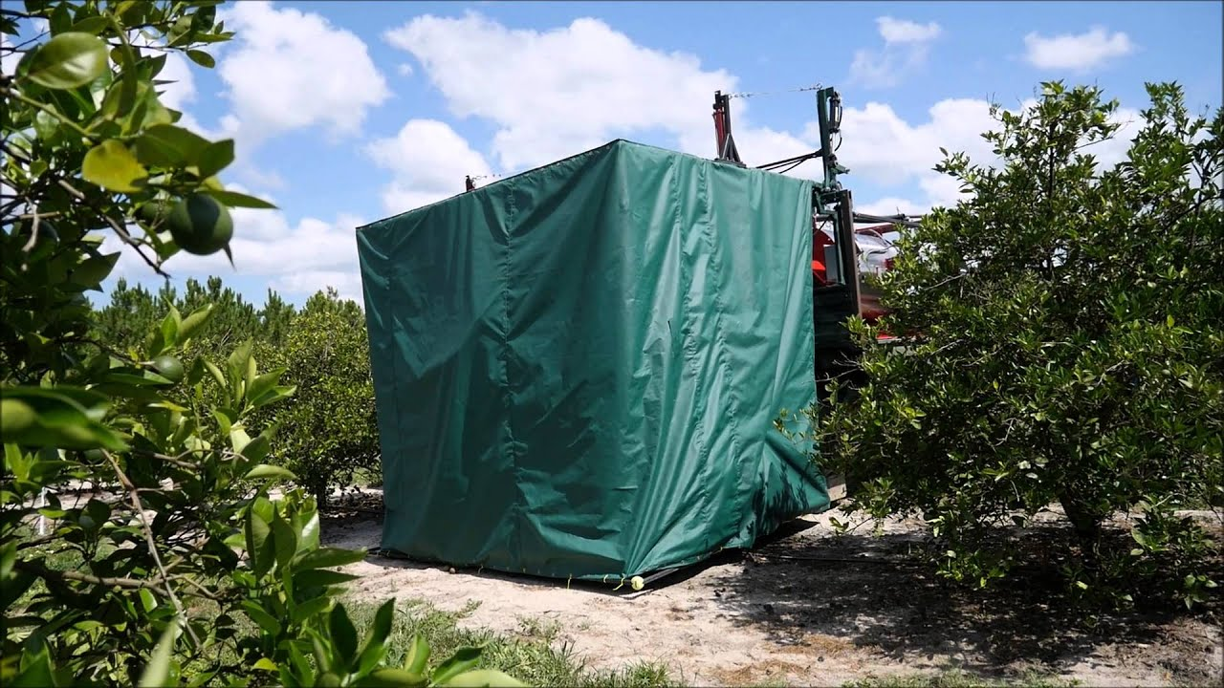
Thermotherapy
(citrus thermotherapy, 2021)

Slide 15
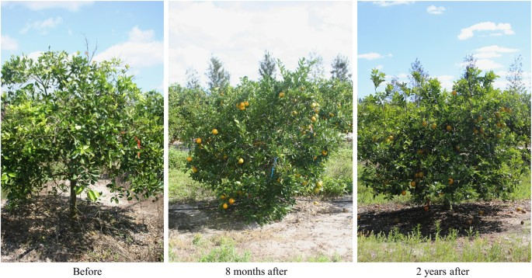
Thermotherapy
(citrus thermotherapy, 2021)

Slide 16
Reflective Mulch

Slide 17
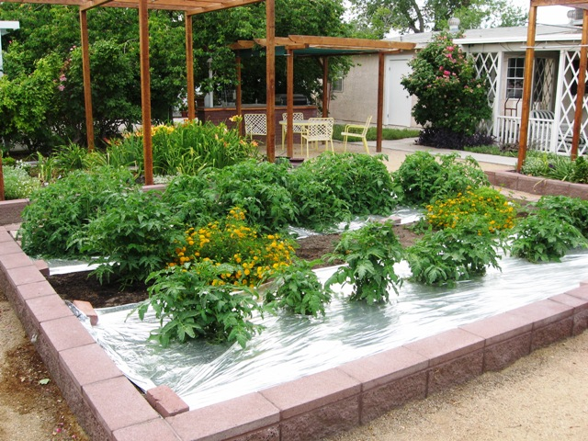
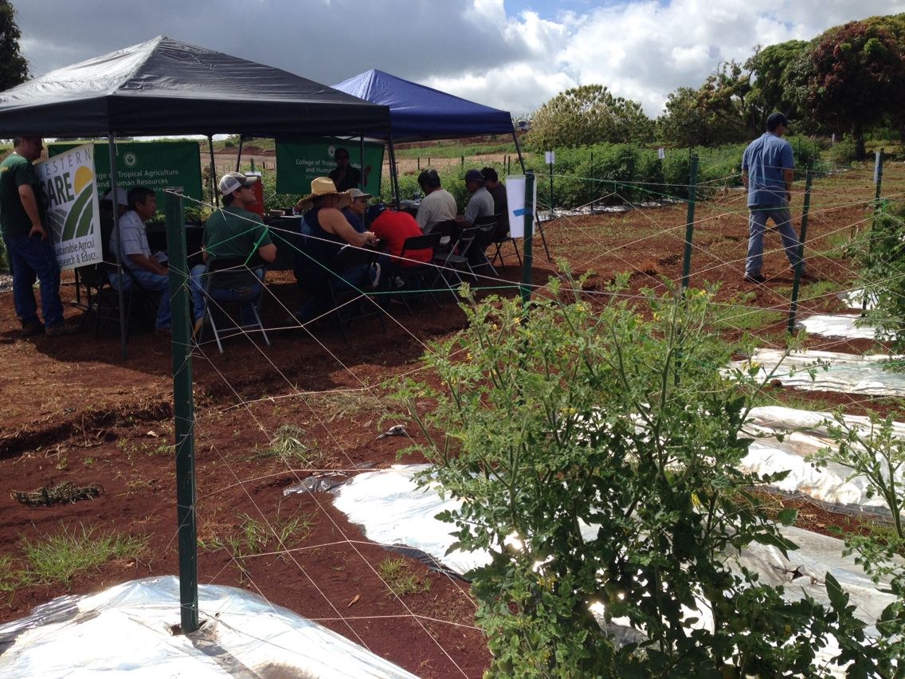
Reflective Mulch
(reflective mulch tomato, 2021)
(reflective mulch tomato, 2021)

Slide 18
It could be better!

Slide 19
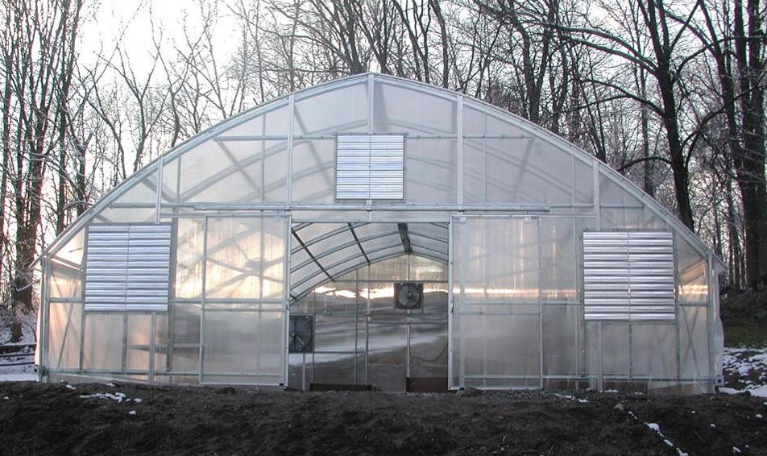
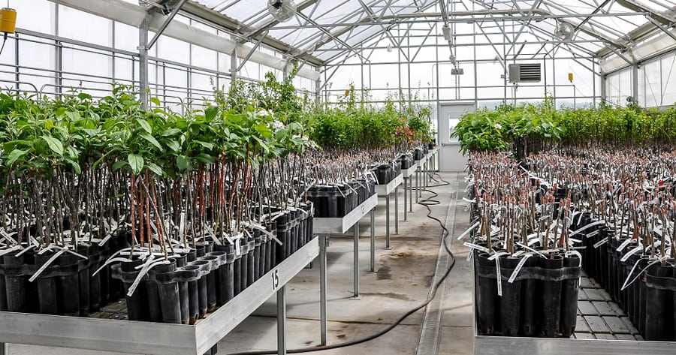
Innovation: Greenhouses & Reflective Mulch
(greenhouse, 2021)
(greenhouse with trees, 2021)

Slide 20
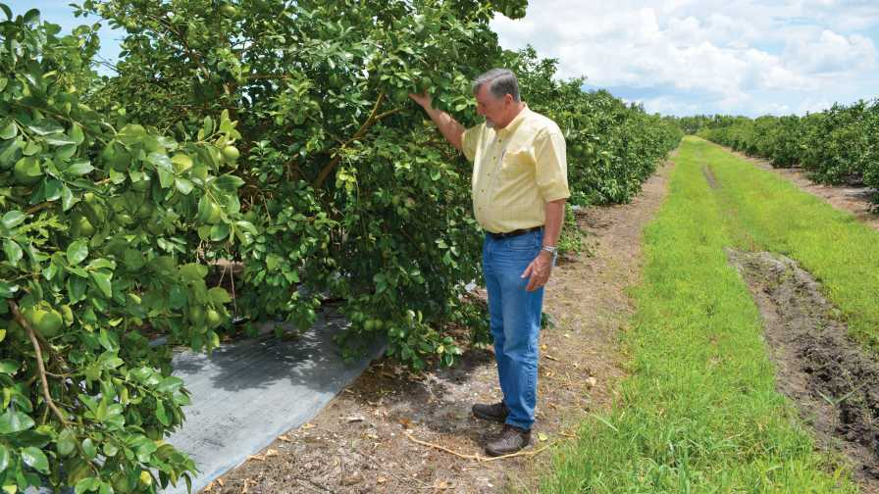
Innovation: Greenhouses & Reflective Mulch
(reflective mulch trees, 2021)

Slide 21
Environment
Animal Life
Citrus Greening
Temperature

Slide 22
Environment
Thermo-therapy
Combination
Reflective Mulch
Citrus Greening

Slide 23
(citrus, 2021)

Slide 25
References
african citrus psyllid. Retrieved February 4, 2021.
african citrus psyllid. Retrieved February 4, 2021.
asian citrus psyllid. Retrieved February 4, 2021.
asian citrus psyllid. Retrieved February 4, 2021.
Citrus. Retrieved January 28, 2021.
citrus thermotherapy. Retrieved February 17, 2021.
citrus thermotherapy. Retrieved February 17, 2021.
Duan, Y. (2013, August). Prescription for Curing Citrus Greening: Apply Heat and Wait. Retrieved February 16, 2021, from https://agresearchmag.ars.usda.gov/2013/aug/citrus.
Elizabeth E. Grafton-Cardwell Ph.D. Retrieved January 21, 2021, from https://ucanr.edu/?facultyid=843
Going Green - But Not the Good Kind: On Climate Change and Plant Pandemics. Retrieved January 19, 2021, from https://www.keapbk.com/blogs/keap/going-green-but-not-the-good-kind-on-climate-change-and-plant-pandemics
Grafton-Cardwell, E. (2020, January 29). Huanglongbing (HLB or Citrus Greening). Retrieved January 21, 2021, from https://cisr.ucr.edu/invasive-species/huanglongbing-hlb-or-citrus-greening#:~:text=The%20Situation%3A%20Citrus%20huanglongbing%20(HLB,greening%20that%20have%20been%20described.
greenhouse. Retrieved February 18, 2021.

Slide 26
References (Cont.)
greenhouse with trees. Retrieved February 18, 2021.
map of florida no words. Retrieved February 4, 2021.
map of united states no words. Retrieved February 4, 2021.
Martin, K., Hodges, A., & Leppla, N. (2017, June). Citrus Pests. Retrieved January 21, 2021, from http://www.idtools.org/id/citrus/pests/factsheet.php?name=African+citrus+psyllid
Orange half. Retrieved February 4, 2021.
Orange with citrus greening disease. Retrieved February 4, 2021.
Patel, C., Srivastava, R., Rana, A., Kunwar, R., Tiwari, J., & Dudpuri, K. (2021, February 12). Evaluation of reflective silver plastic mulch on controlling whitefly and associated disease incidence on tomato crop. Retrieved February 18, 2021, from https://www.entomoljournal.com/archives/?year=2021&vol=9&issue=1&ArticleId=8365
reflective mulch trees, 2021. Retrieved February 17, 2021.
reflective mulch tomato. Retrieved February 17, 2021.
reflective mulch tomato. Retrieved February 17, 2021.
Xia, Y., Deng, X., Fan, G., Sequeira, R., Takeuchi, Y., & Baez, I. (2016). Impact of high temperature on huanglongbing for development of a field management strategy. Citrograph, 44-50.
Yongping Duan. Retrieved February 16, 2021, from https://www.linkedin.com/in/yongping-duan-37aa183b
Yulu Xia. Retrieved January 19, 2021, from https://cipm.ncsu.edu/people/yuluxia/

